Slide 1
I CAN CHILDREN'S GLOBAL SUMMIT
TRAVEL RECOMMENDATIONS FOR ROME
2019

Slide 2
ONE DAY TOUR RECOMMENDATIONS

Slide 3
ONE DAY TOUR RECOMMENDATIONS
CATEGORY
PLACE
LINK
TRADITIONAL/HISTORY
COLOSSEUM
(COLOSSEO)
https://travel.usnews.com/Rome_Italy/Things_To_Do/Colosseum_Colosseo_28757/
ROMAN
FORUM
https://en.wikipedia.org/wiki/Roman_Forum
THE PANTHEON
https://travel.usnews.com/Rome_Italy/Things_To_Do/Pantheon_28743/
SIGNATURE ATTRACTIONS
TREVI FOUNTAIN
FONTANA DI TREVI
https://travel.usnews.com/Rome_Italy/Things_To_Do/Trevi_Fountain_Fontana_di_Trevi_28758/
CASTEL SANT’ANGELO
https://en.wikipedia.org/wiki/Castel_Sant%27Angelo

Slide 4
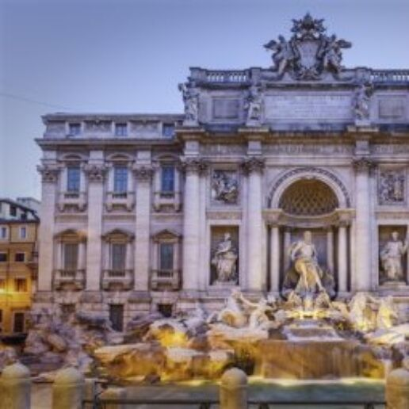
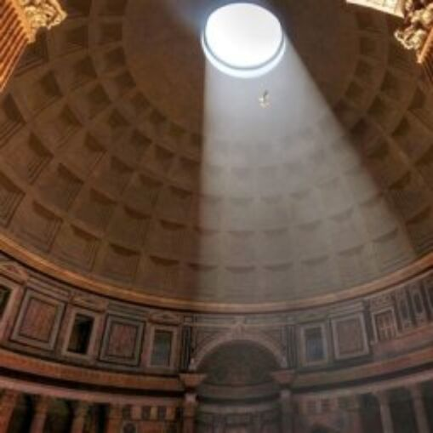
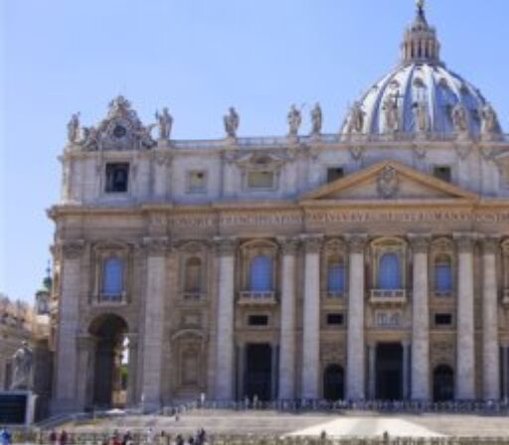
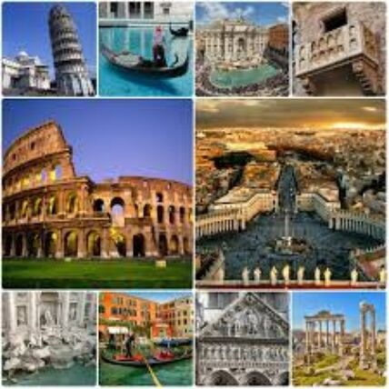
ONE DAY TOUR RECOMMENDATIONS
CATEGORY
PLACE
LINK
https://travel.usnews.com/Rome_Italy/Things_To_Do/Vatican_Museums_28756/
MUSEUM
VATICAN MUSEUM
https://travel.usnews.com/Rome_Italy/Things_To_Do/St_Peter_s_Basilica_Basilica_di_San_Pietro_33532/
CHURCH
ST. PETER'S BASILICA
PARKS
VATICAN GARDENS
https://en.wikipedia.org/wiki/Gardens_of_Vatican_City

Slide 5
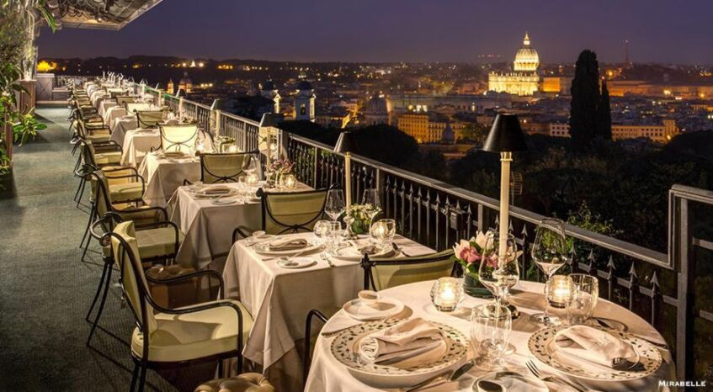
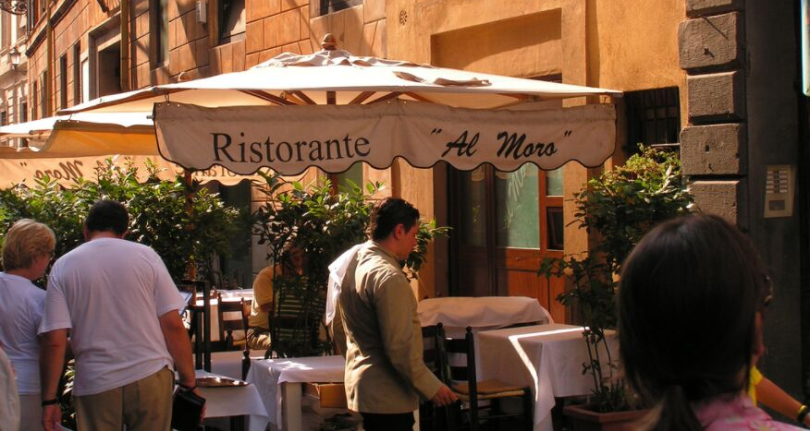
FAMOUS PLACES TO EAT
Source: https://images.app.goo.gl/BM3nftw3Y5SYT2dt5
Source: https://images.app.goo.gl/aKes5STtZwbV1k9q9
MORE INFORMATION ABOUT THE FOLLOWING RESTAURANTS CAN BE FOUND OUT AT
https://www.seriouseats.com/2014/07/best-restaurants-where-to-eat-rome.html

Slide 6
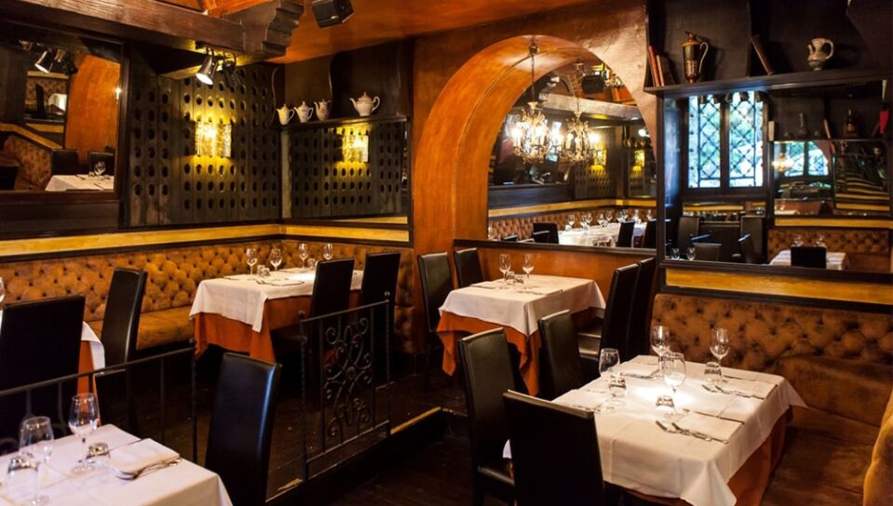
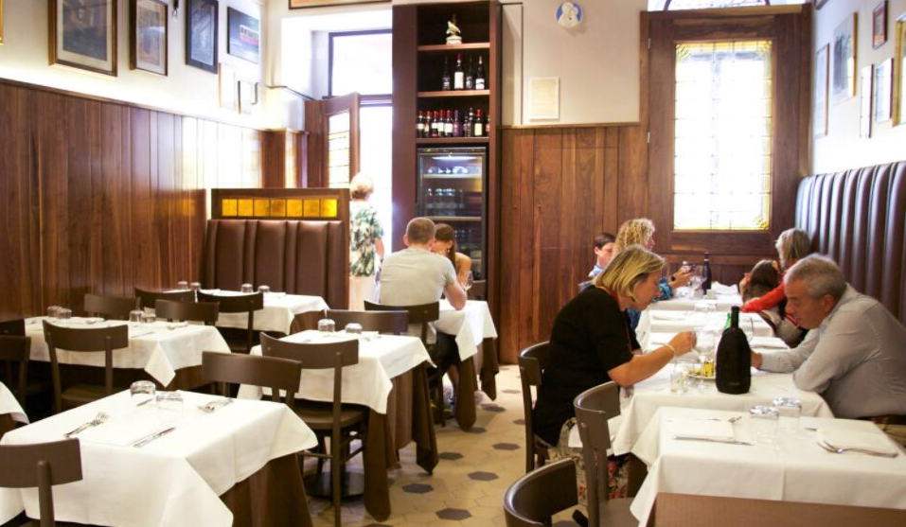
FLAVIO AL VELAVEVODETTO
Testaccio's Monte dei Cocci is a heap of ancient remains which now serves as a place for various restaurants. Flavio Al Valavevodetto is famous for romanian classics such as cacio e pepe, carbonara, etc. You will also get a chance to taste the much known desert Tiramisu in its truest form.
ARMANDO AL PANTHEON
The simple dishes chef Claudio Gargioli is known for, like spaghetti alla gricia and spaghetti aglio. he depth of flavor of his coda alla vaccinara
(braised oxtail) is unmatched in the city. Book well in advance, order every course, and see why Romans have been infatuated with this institution for over five decades

Slide 7
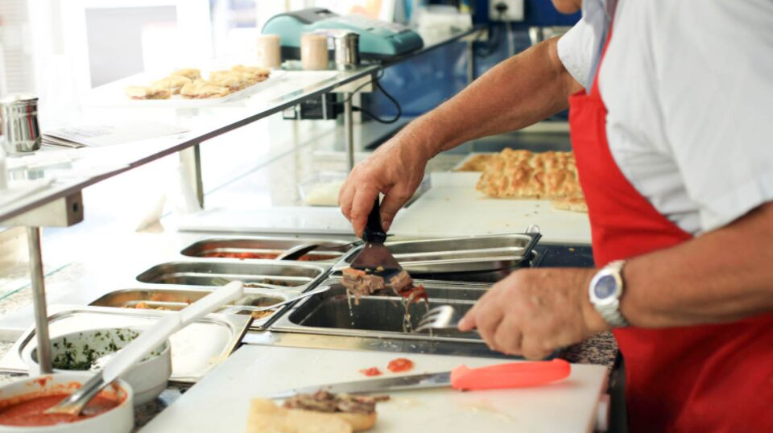
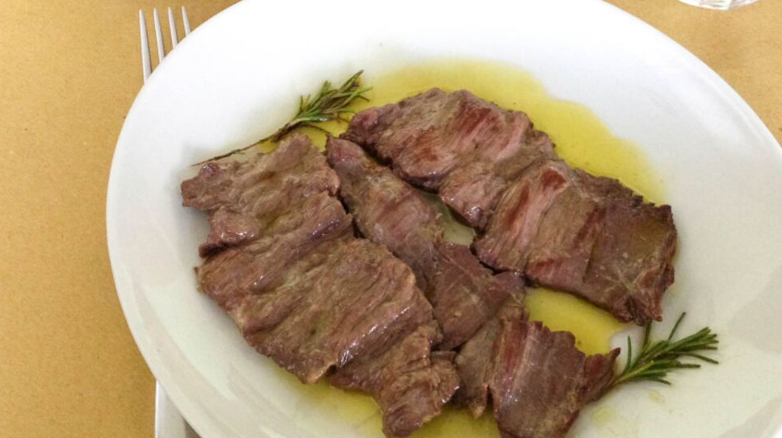
MORDI E VAI
Sergio Esposito serves homemade-tasting bite, based on the family recipes serves which are sold at just €3. The specialties include sandwiches stuffed with hearty Roman dishes such as braised beef, meatballs, boiled beef, and tripe in tomato sauce. Do not miss the fried meatballs, which are sold piece by piece after they are breaded and fried.
OSTERIA BONELLI
Famous for its simple eatery, Osteria Bonelli is a restaurant in Tor Pignattara. Its daily menu has a lot of vegetables side dishes which are considered good for digestion. But, you can expect to find grilled and fried fish specials on Fridays. One has to get off the Berardi stop from the Giardinetti-bound commuter train to reach the restaurant.

Slide 8
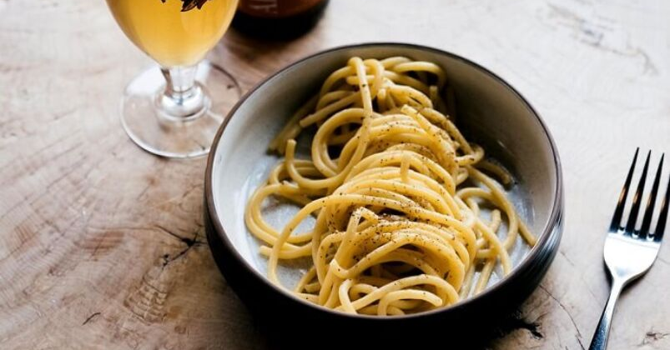
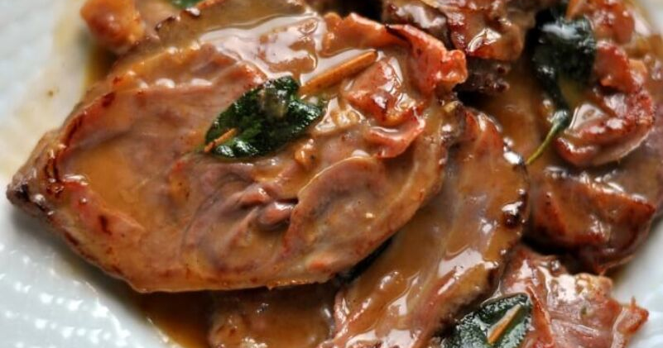
TOP 10 MOST FAVORED ROMAN DISHES
1. Carciofi alla Romana (Artichokes)
2. Carbonara (Roman-Style Pasta Dish)
3. Pizza al Taglio (Pizza By The Slice)
4. Supplí (Deep Fried Rice Croquettes)
5. Filetti di Baccalá (Fried Cod Fish)
6. Cacio e Pepe (Pasta With Cheese & Pepper)
7. Trippa alla Romana (Roman-Style Tripe)
8. Saltimbocca alla Romana (Veal With Ham & Sage)
9. Coda alla Vaccinara (Oxtail Stew)
10. Maritozzo (Sweet Bread Roll)
For More Information on the same, please visit
https://traveltriangle.com/blog/roman-food/

Slide 9
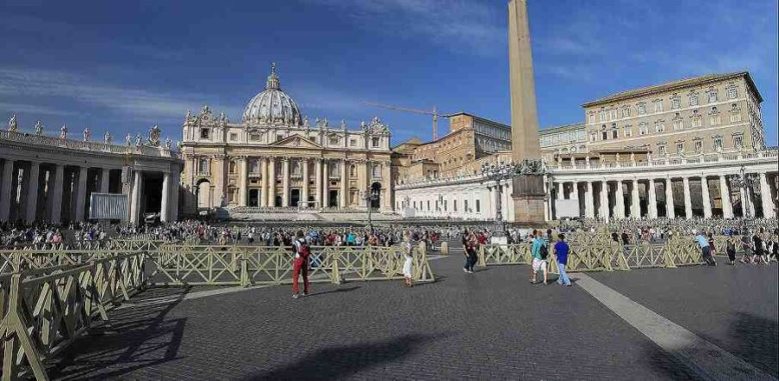
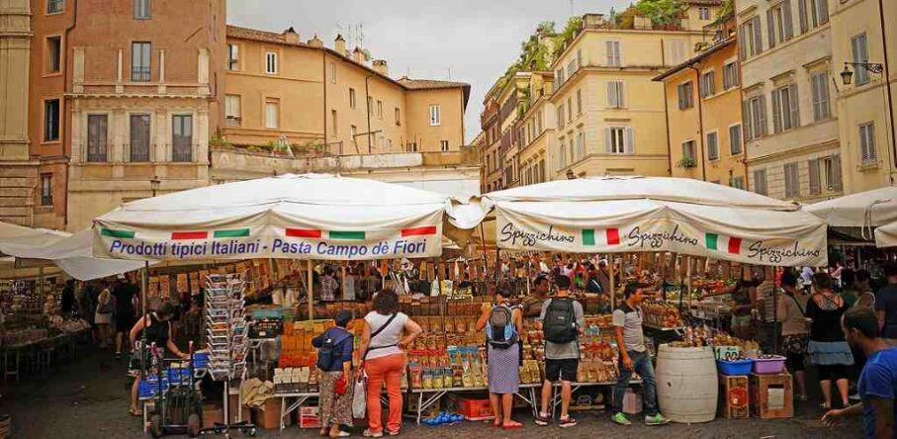
TOP 10 BEST THINGS TO DO IN ROME
1. Hang Out in the Pantheon
2. Walk Through History in the Roman Forum
3. Circle the Colosseum, Inside & Out
4. Get a Tour of Vatican City
5. Stroll the Trastevere Streets
6. Check Out the Cappuchin Crypt
7. Eat Something Typically Roman
8. Do Some People-Watching at the Trevi Fountain
9. Visit Another Church in Rome
10. Browse the Campo dei Fiori Markets
For More Information on the same, please visit
https://www.italylogue.com/featured-articles/top-10-things-to-do-in-rome/

Slide 10
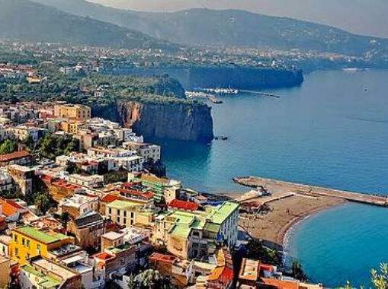
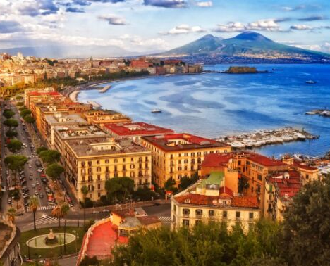
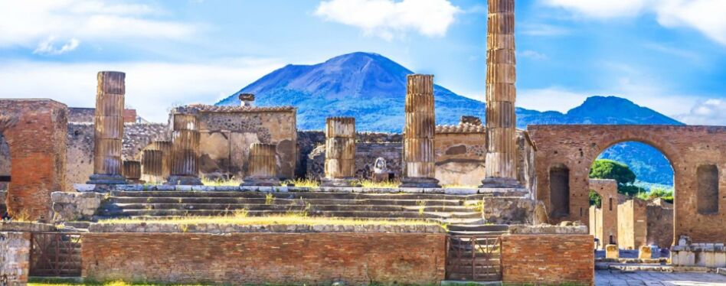
MULTIPLE DAYS TOUR RECOMMENDATIONS
SORRENO
NAPLES
POMPEII
PLEASE NOTE THAT IT IS JUST AN OPTION & ALL THE BOOKINGS HAVE TO BE DONE BY THE PARTICIPANTS THEMSELVES.
TO BOOK, VISIT THE FOLLOWING LINK
VILLA COMUNALE
MOUNT VESUVIUS VOLCANO SITE
FAMOUS FOR ITS UNESCO LISTED RUINS
MUSEUM CORREALE
CASTEL NUOVO
HOUSE OF THE FAUN
PIAZZA TASSO
ROYAL PALACE OF NAPLES
https://www.viator.com/tours/Rome/3-Day-Italy-Trip-Naples-Pompeii-Sorrento-and-Capri/d511-5034ROM17
TEMPLE OF APOLLO
SAN FRANCESCO MONASTRY
CAPRI BOAT RIDE
HOUSE OF THE VETTII

Slide 11
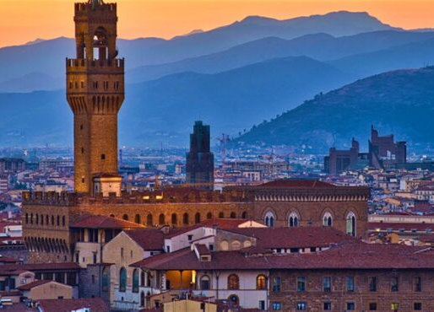
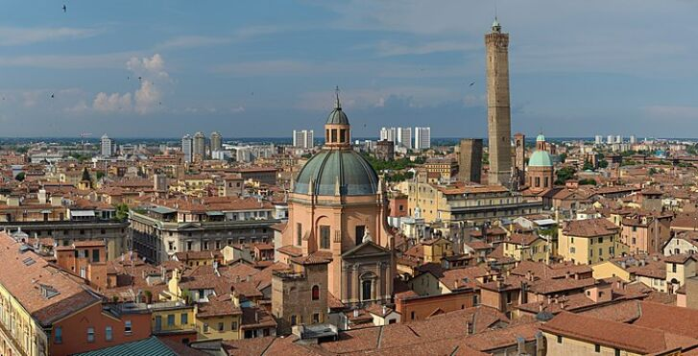
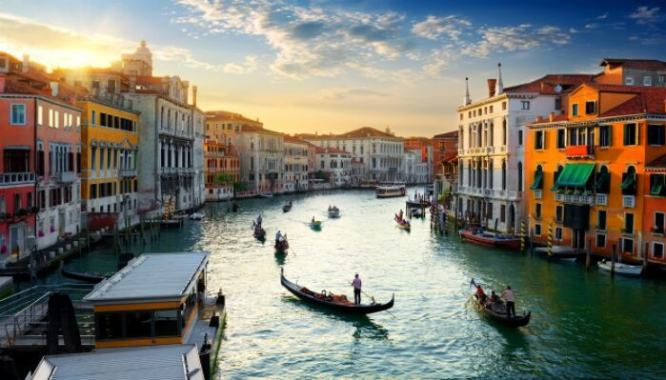
MULTIPLE DAYS TOUR RECOMMENDATIONS
FLORENCE
BOLOGA
VENICE
PLEASE NOTE THAT IT IS JUST AN OPTION & ALL THE BOOKINGS HAVE TO BE DONE BY THE PARTICIPANTS THEMSELVES.
TO BOOK, VISIT THE FOLLOWING LINK
SANTA MARIA DEL FIORE
KING RENZO'S PALACE
ST. MARK'S BASILICA
CAMPANILE
PALAZZO PODESTA
PALAZZO DEI DOGI
PIAZZA DELLA SIGNORIA
BASILICA OF SAN PETRONIO
https://graylinerome.com/tours/rome/unesco-jewels-best-of-italy-rome-florence-venice-in-5-days-9888_119/
PIAZZA SAN MARCO
BASILICA OF SANTA CROCE
PORTICOS
RIALTO BRIDGE

Slide 12
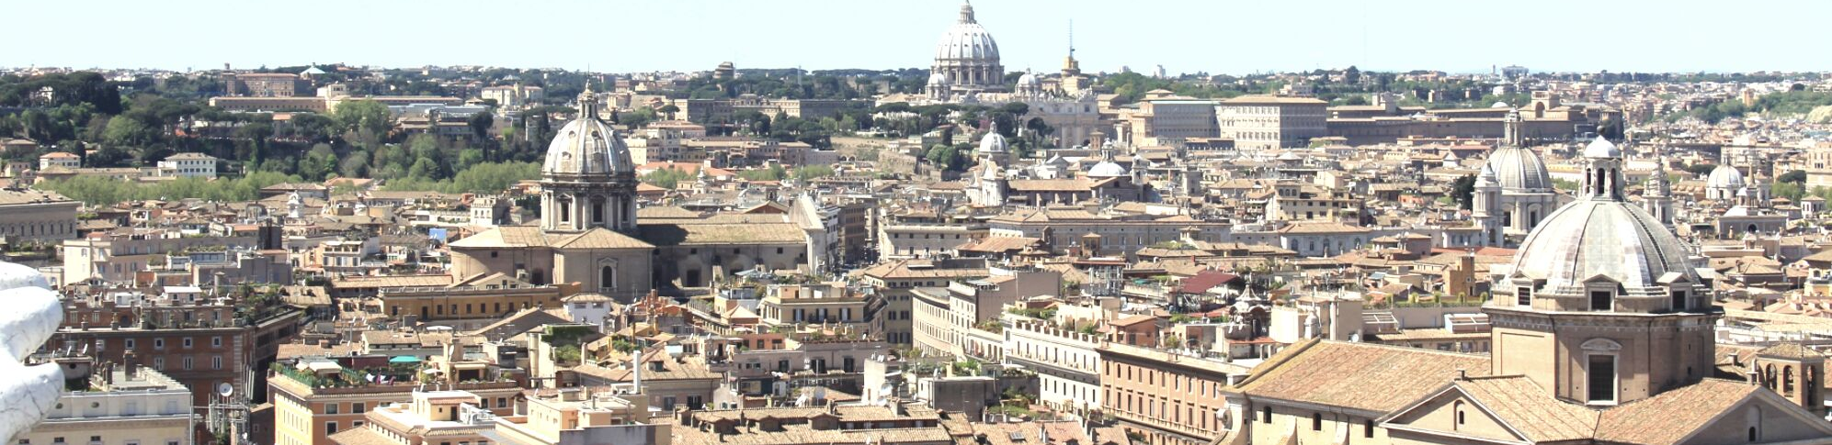
1. OFFICIAL TOURISM WEBSITE
FOR MORE INFORMATION VISIT
2. TOURISM- TRIPADVISOR
3. TOURISM- LIFEHACKER
4. THE TRAVEL HACK
5. ITALY GUIDES

